Slide 1
Virtual-Memory Chapter 10
Benefits of Virtual Memory
Demand Paging
Working-set Model of a Process
Shared memory and Memory-mapped files
How to manage Kernel memory

Slide 2

Virtual-Memory Management
Virtual address space
Demand paging
First reference and Page fault
Page fault rate
Page replacement algorithms
FIFO Optimal
LRU Second chance
Frame allocation policy
Fixed and dynamic
Working-set Model
Thrashing
Contiguous allocation of pages
Buddy system and slab allocation
I/O locking and pre-paging

Slide 3
Introduction
Multiprogramming requires that entire processes are in memory before they start execution
Virtual memory allows execution of processes that are not completely in memory
Programs can be larger than physical memory
Frees programmers from the burden of memory-storage limitations
Sharing of files and memory can be implemented easily
It provides an efficient mechanism for process creation
May decrease performance if used carelessly
Demand paging, its complexity and cost

Slide 4
Background
Dynamic linking can be used to overcome the restriction of entire process in memory in order to execute the process
Requires special precautions and extra work by the programmer
In many cases, the entire program is not needed for execution
Programs have code to handle unusual error conditions
Arrays, lists and tables are allocated more memory than they actually need
Certain options and features of a program may be used rarely
Even if the entire program is needed, it may not all be needed at the same time

Slide 5
Background
The benefits of executing partially loaded programs
Program is not constrained by the amount of available physical memory
More programs can be run at the same time
Better utilization and higher throughput
Each user program runs faster
Less I/O is needed to load or swap user programs
Virtual memory allows for the separation of user address space and physical address space
Allows a large virtual address for a small physical memory

Slide 6
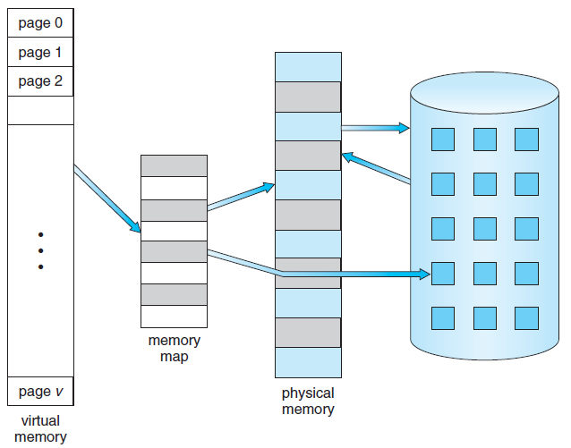
Virtual Memory That is Larger Than Physical Memory
⇒
Notes:
6

Slide 7
Background
Virtual address space of a process: Logical view of how a process is stored in memory
This is contiguous
Physical frames are distributed in memory
Virtual address spaces that includes holes are referred as sparse address spaces
Useful for stack or heap segments
Files or memory can be shared using page sharing implemented in virtual memory
Benefits
System libraries can be shared by processes
Virtual memory enables processes to share memory for interprocess communication
Process creation can be sped up by allowing pages to be shared using fork() system call

Slide 8
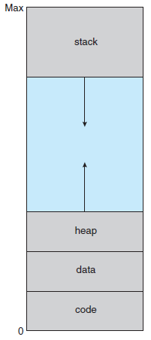
Virtual-address Space of a Process in Memory
Notes:
8

Slide 9
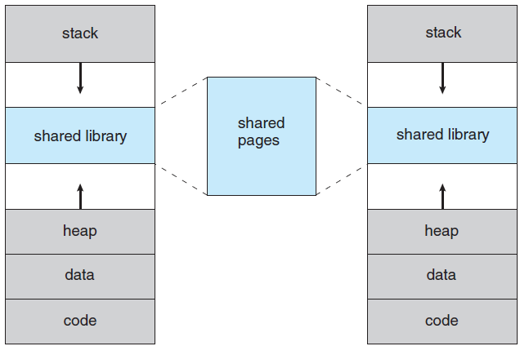
Shared Library Using Virtual Memory
Notes:
9

Slide 10
Demand Paging
Load pages of a process into memory as they are needed
Demand paging
Commonly used technique in virtual memory
Similar to a paging system with swapping
Processes reside in secondary memory
Swapped into memory for execution when the demand is made
Main benefit of virtual memory
Load only the portions of programs that are needed
Memory is used efficiently

Slide 11
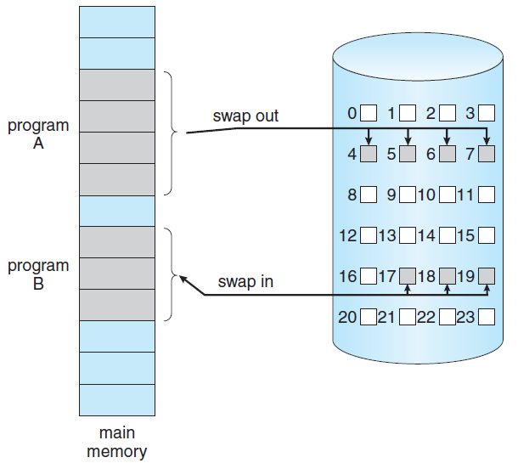
Transfer of a Paged Memory to Contiguous Disk Space
Notes:
11

Slide 12
Basic Concepts of Demand Paging
When a process is brought into memory
Only a subset of its pages are loaded
Pager avoids reading into memory the pages that will not be used
Hardware support is required to distinguish between pages that are in memory and the ones that are on the disk
Valid-invalid bit can be used for this purpose
If the access is limited to memory-resident pages
Execution proceeds normally
If the process tries to access a page not brought into memory
It causes a page-fault trap

Slide 13
Valid-Invalid Bit
Frame #
valid-invalid bit
4
v
8
v
2
v
9
v
i
….
i
i
page table
Notes:
13

Slide 14
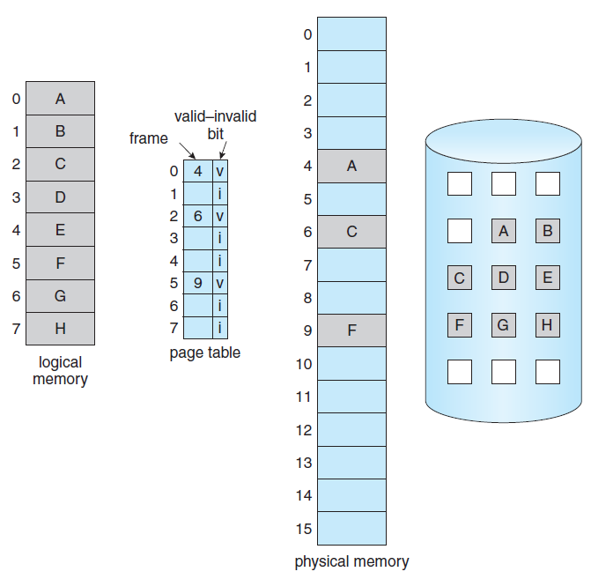
Page Table With Some Pages Not in Main Memory
Notes:
14

Slide 15
Demand Paging
Procedure followed for handling the page fault
Check an internal table (kept in PCB) to determine the validity of the reference
In case of invalid reference, process is terminated
If the reference is valid, the referenced page is to be brought in
Find a free frame from a free frame list
Schedule a disk operation to read the desired page into the allocated frame
Modify the internal table of the process to record this change
Restart the instruction that was interrupted due to the trap

Slide 16
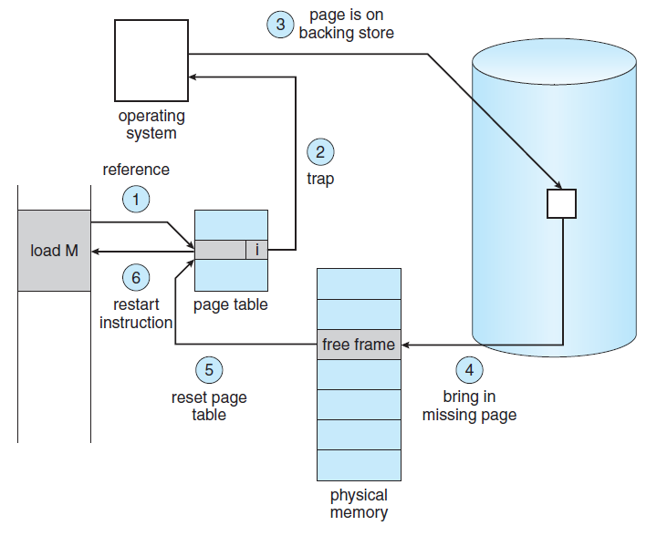
Steps in Handling a Page Fault
Notes:
16

Slide 17
Demand Paging
Pure demand paging
A process starts with no page in memory
It faults a number of times to load the required pages
Some programs may generate multiple page faults per instruction
This results in unacceptable system performance
Programs tend to have locality of reference
This results in reasonable performance from demand paging
Hardware to support demand paging
Page table with the ability to mark a page as valid or invalid
Secondary memory to hold pages that are not in memory– swap device and swap space

Slide 18
Demand Paging
Problem of restarting an instruction exactly at the same place after a page fault is handled
Fault may occur when the instruction is fetched
Restart the operation of fetching
Fault may occur when data is fetched
Restart the instruction that caused the fault
Problem occurs
When an instruction already modifies several locations and then the fault occurs
IBM System 360/370 MVC instruction
Move up to 256 bytes from one memory location to another
What happens if fault occurs after some bytes have already been moved

Slide 19
Demand Paging
There are two ways of solving this problem
Microcode computes and attempts to access both ends of both blocks
Start moving only when both blocks are in memory
Use temporary registers to hold the value of overwritten locations
Restore the contents if page fault occurs
Restart the instruction after the fault is handled
This is not the only problem introduced because of adding demand paging

Slide 20
Free Frame List
When a page fault occurs, the operating system must bring the desired page from secondary storage into main memory into a free frame
OS maintains a free-frame list
A pool of free frames for satisfying such requests.
Operating system typically allocate free frames using a technique known as zero-fill-on-demand The content of the frames are zeroed-out before being allocated
When a system starts up, all available memory is placed on the free-frame list

Slide 21
List of Free Frames

Slide 22
Performance of Demand Paging
Compute the effective access time for a demand-paged memory
Effective access time =
(1 – p) x ma + p x page fault time
Where ma = memory access time
p = probability of a page fault
Page fault time involves a number of steps
Time incurred is large enough to force context-switch
CPU is allocated to another process while page fault is serviced
Three major components of page fault service time
Service the page fault interrupt

Slide 23
Page Fault Service Sequence of steps
1. Trap to the operating system
2. Save the user registers and process state
3. Determine that the interrupt was a page fault
4. Check that the page reference was legal and determine the location of the page on disk
5. Issue a read from the disk to a free frame:
a. Wait in a queue for this device until the read request is serviced.
b. Wait for the device seek and/or latency time.
c. Begin transfer of page to a free frame.
6. While waiting, allocate the CPU core to some other process (CPU scheduling, optional).

Slide 24
Page Fault Service Sequence of steps
7. Receive an interrupt from the disk I/O subsystem (I/O completed).
8. Save the registers and process state for the other process (if step 6 is executed).
9. Determine that the interrupt was from the disk.
10. Correct the page table and other tables to show that the desired page is now in memory.
11. Wait for the CPU to be allocated to this process again.
12. Restore user registers, process state, and new page table - then resume the interrupted instruction.

Slide 25
Performance of Demand Paging
2. Read in the page
3. Restart the process
(1) and (3) can be reduced by careful coding
May take from 1 to 100 microseconds each
If the average time to service a page-fault = 8 mS
Memory access time = 200 nanoseconds
Effective access time = 200 + 7999800 p
If p = 0.001
Effective access time = 8.2 µS
Effective memory access time is directly proportional to the page fault rate
If the performance degradation is desired to be less than 10%
Then p < 0.0000025

Slide 26
Performance of Demand Paging
Page-fault rate should be kept low in a demand-paging system
Affects the effective access time, slowing down the process execution time
Another aspect of demand paging is the handling and use of swap space
Disk I/O to swap space is faster than to the file system
Swap space is allocated in much larger blocks
Copy entire file system in swap space at startup of the process
Perform demand paging from swap space
Another option is to write pages to the swap space as they are replaced

Slide 27
Copy-on-Write
Process creation through fork() system call bypasses the basic demand paging technique
Child process is an exact duplicate of the parent process
All pages are shared between the two processes
Shared pages that are expected to be modified are marked as copy-on-write
Copy-on-write allows a copy of the shared page to be made in case of write by any of the processes
Many operating systems provide a pool of free pages for such allocations
Zero-fill-on-demand pages

Slide 28
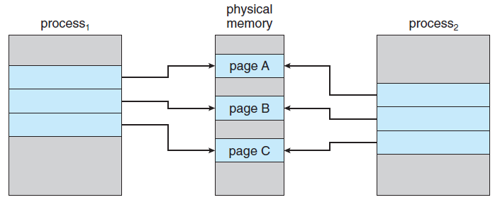
Before Process 1 Modifies Page C
Notes:
28

Slide 29
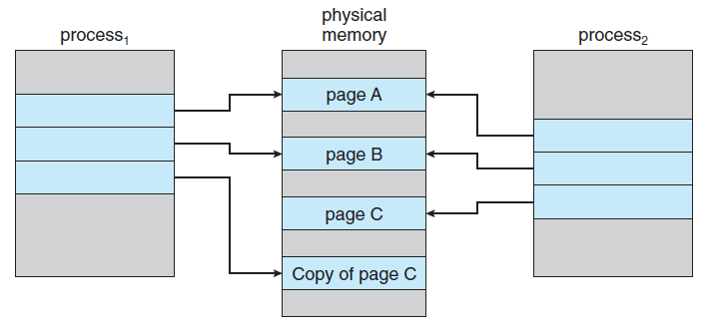
After Process 1 Modifies Page C
Notes:
29

Slide 30
Page Replacement
By allocating memory to processes partially, degree of multiprogramming can be increased
Over-allocation of memory takes place
Processes may demand a larger number of frames than the allocated numbers
I/O buffers are also allocated memory
What happens if a page fault occurs and there are no free frames available?
Solutions
OS terminates the process that is demanding more frames
Paging should be logically transparent to user
Swap out the process, reducing the degree of multiprogramming
Instead, use page replacement as the solution

Slide 31
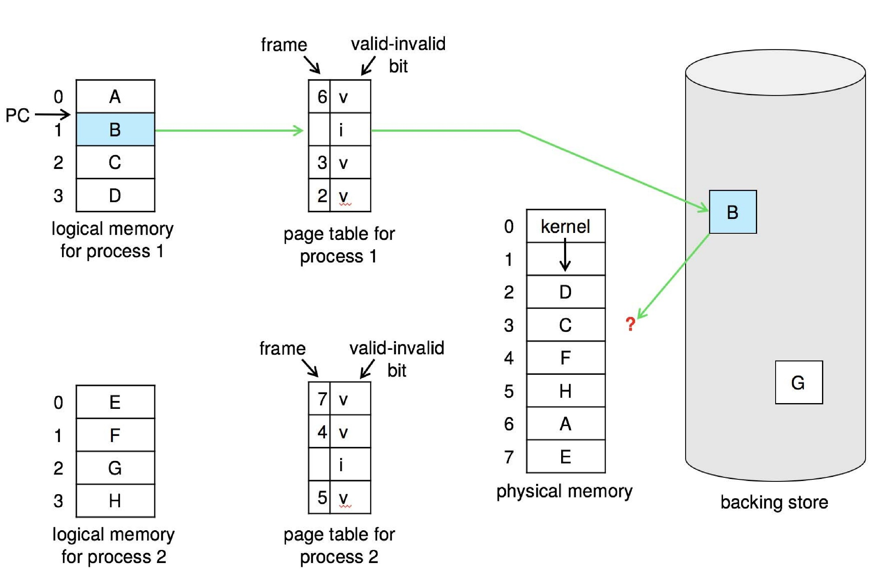
Need For Page Replacement
Notes:
31

Slide 32
Basic Page Replacement
If no frame is free, select a frame that is not currently in use
Write its contents to swap space and change the contents of the page table
Page fault-service routine should include the page replacement step
Two page transfers are done if no frame is free
Page-fault service time doubles
Modify or dirty bit can be used to improve the page-fault service time
The same principle can be applied for read- only pages

Slide 33
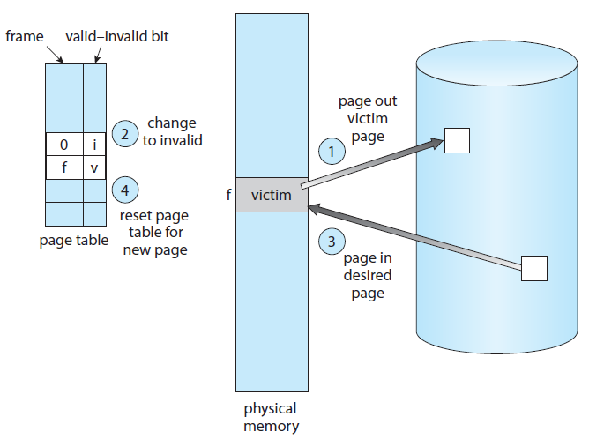
Page Replacement
Notes:
33

Slide 34
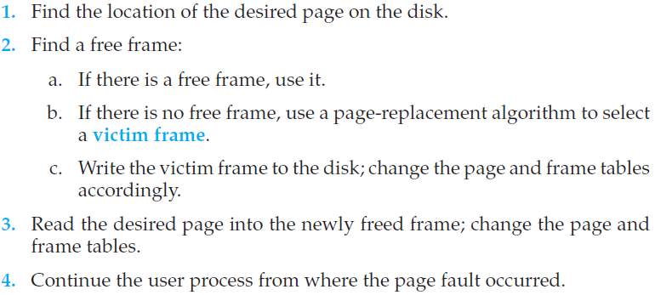
Page fault service routine modified
Notes:
34

